Slide 1
A Second Look at Enrollment Changes After the Kalamazoo Promise
Brad Hershbein
W.E. Upjohn Institute for Employment Research
October 11, 2013
Presentation at Lumina Foundation, Indianapolis, IN
Presentation briefly summarizes full paper, available at
http://research.upjohn.org/up_workingpapers/200/

Slide 2
Research Questions
As more localities consider Promise-type programs, important questions remain:
Where do new students come from? Where would leavers have gone?
What are the characteristics of new students? Leavers?
How does school-sorting behavior change?
Strength of Promise-type program as economic development tool rests on understanding these relationships
Notes:
Where?: same metro area, elsewhere in state, outside state; from other public districts or from privavtes/charters
Characteristics?: SES, academic aptitude
School?: new students pick schools that look better on paper or in better neighborhoods

Slide 3
Main Results
More than 1/2 of the 2006 influx came from other MI districts, 1/4 came from outside the state, and the rest were split between charters and privates
Of those from other MI districts, 90 percent came from elsewhere within Kalamazoo County
80 percent of the immediate drop in exits is from K County, but this share falls to 50 percent over time
New students in 2006 were less poor and had higher test scores than previously; this continues in 2007 but not afterward
No evidence that new students in 2006 chose “good” schools

Slide 4
Data and Strategy
Primary Source: KPS student-level records
Longitudinal, match students across years 1997 through 2010
Has school-level enrollment dates, entry/exit codes, demographics, and test scores
Secondary source: published enrollment
Annual, grade-level headcount data for each district, private, charter school
Identification (causality) at aggregate level is hard
Interrupted time-series design
Notes:
Importance of administrative data for any detailed longitudinal analysis

Slide 5
Inflows and Outflows
Difference: 2006 less 2003-2005 avg
Other MI district | 303
Outside of MI | 122
Private | 37
Charter | 34
First school entry | –6
Other | –10
Total | 482
% share of difference
Other MI district | 63
Outside of MI | 25
Private | 8
Charter | 7
First school entry | –1
Other | –2
Total | 100
Difference: Post 2005 less 2002-2004 avg
Other MI district | –111
Outside of MI | –35
Private | 1
Charter | –18
Dropout | 10
Graduated | 12
End-of-year | –265
Other | –28
Total | –434
% -point change in exit rate
Other MI district | –1.3
Outside of MI | –0.4
Private | 0.0
Charter | –0.2
Dropout | –0.0
Graduated | 0.1
End-of-year | –3.1
Other | –0.3
Total | –5.2
Notes:
Importance of administrative data for any detailed longitudinal analysis

Slide 6
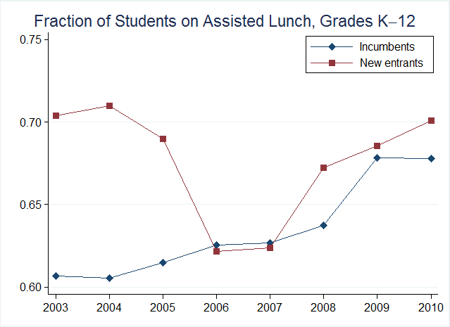
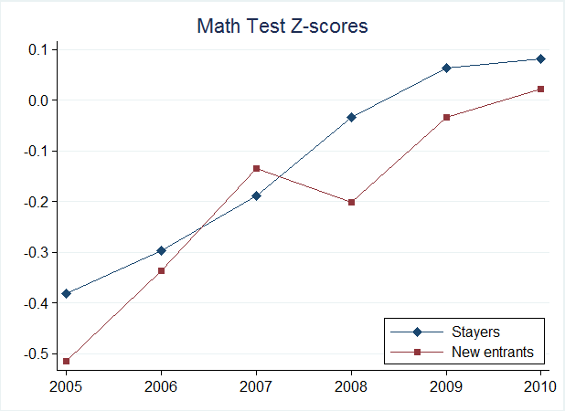
Student Characteristics
Notes:
Importance of administrative data for any detailed longitudinal analysis

Slide 7
School Sorting
A: Elementary | Lunch²⁰⁰³⁻²⁰⁰⁵ | MEAP²⁰⁰³⁻²⁰⁰⁵ | P²⁰⁰³⁻²⁰⁰⁵ | dP²⁰⁰⁶ | dP²⁰⁰⁷⁻²⁰⁰⁸
Arcadia | 0.649 | –0.077 | 0.040 | 0.0001 | 0.0024
Edison | 0.927 | –0.515 | 0.063 | –0.0074 | 0.0106*
Greenwood | 0.663 | –0.406 | 0.029 | –0.0058 | 0.0001
Indian Prairie | 0.286 | 0.478 | 0.050 | –0.0025 | –0.0013
King-Westwood | 0.420 | –0.118 | 0.069 | 0.0028 | 0.0129**
Lincoln | 0.801 | –0.696 | 0.073 | 0.0249** | 0.0053
Milwood | 0.702 | –0.561 | 0.084 | 0.0084 | 0.0110
Northeastern | 0.823 | –0.775 | 0.065 | –0.0032 | –0.0036
Northglade | 0.759 | –1.288 | 0.056 | –0.0062 | –0.0295**
Parkwood-Upjohn | 0.541 | –0.540 | 0.068 | 0.0084 | 0.0130**
Prairie Ridge | 0.566 | –0.046 | 0.062 | 0.0009 | 0.0167**
Spring Valley | 0.713 | –0.788 | 0.052 | –0.0005 | –0.0139**
Washington | 0.884 | –0.357 | 0.061 | 0.0007 | 0.0090
Winchell | 0.362 | 0.178 | 0.062 | –0.0102 | –0.0017
Woods Lake | 0.812 | –1.013 | 0.106 | –0.0094 | –0.0360**
Woodward | 0.709 | –0.380 | 0.063 | –0.0010 | 0.0050
Notes:
Elementary schools in KPS; distribution of new students. Schools in blue look better on paper, schools in red look worse.

Slide 8
Conclusion
Good news: Promise can attract (and keep) students and families from outside area
Larger economic impact: new home, new job, etc.
Less good news: Can also poach students from troubled neighboring districts
Cautionary good news: Selection is modestly positive
But not enough to change distribution district-wide
Cautionary less good news: increased school-sorting over time
But probably due more to test score reporting than Promise
Notes:
School sorting: more inequality across schools

