Slide 1
Research, Policy, & Outcomes for Students and Communities
Dr. Michelle Miller-Adams
W.E. Upjohn Institute
Grand Valley State University
Dr. Jennifer Iriti
Evaluation for Learning Group
University of Pittsburgh - LRDC
PromiseNet 2019 – Berkeley, CA
Notes:
Michelle slides 1-7

Slide 2
Presentation outline
The College Promise Landscape
Research Summaries and Spotlights
K-12 impacts
Postsecondary impacts
Community/economic development impacts
Research Resources – College Promise Campaign

Slide 3
The College Promise Landscape
Statewide
College- initiated
Community-initiated
Tennessee Promise
Oregon Promise
Excelsior Scholarship (New York)
Kalamazoo Promise
Pittsburgh Promise
El Dorado Promise
Richmond Promise
Ventura College Promise
Santa Barbara City College Promise
Milwaukee Area Technical College Promise
Notes:
Note that definition of Promise program is contested, with narrower and broader approaches. Reflective of the ad hoc, bottom-up nature of the Promise movement but problematic for research and analysis – what counts as Promise is variable, depending on who’s doing the counting.

Slide 4
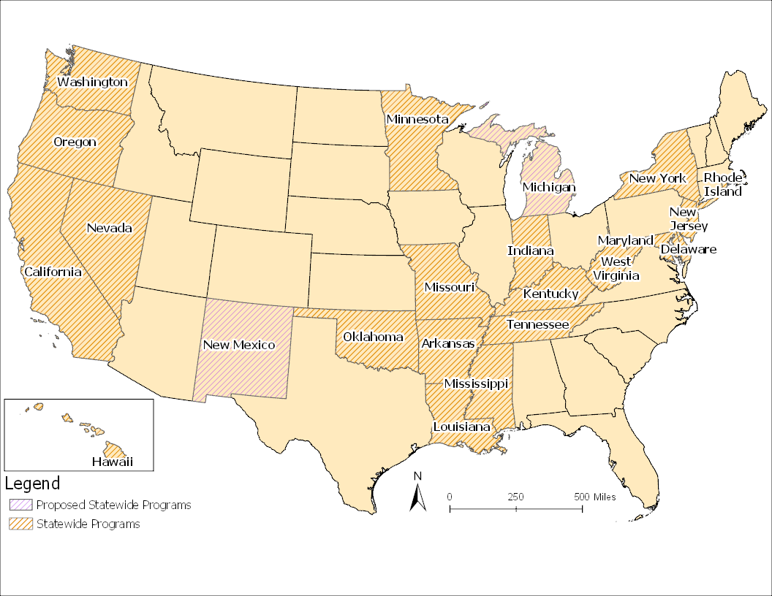
The Promise Landscape: Statewide programs (n=21) * Based on Century Foundation definition (Mishory 2019)

Slide 5
The Promise Landscape: Community-initiated programs (n= 57)

Slide 6
The Promise Landscape: College-initiated programs* (n=86) * For complete list of California programs see WestEd map
Notes:
Note that West Ed has 130 California Promise programs on its map. Almost every cc in California has started a Promise program since AB 19 was passed in 2018.

Slide 7
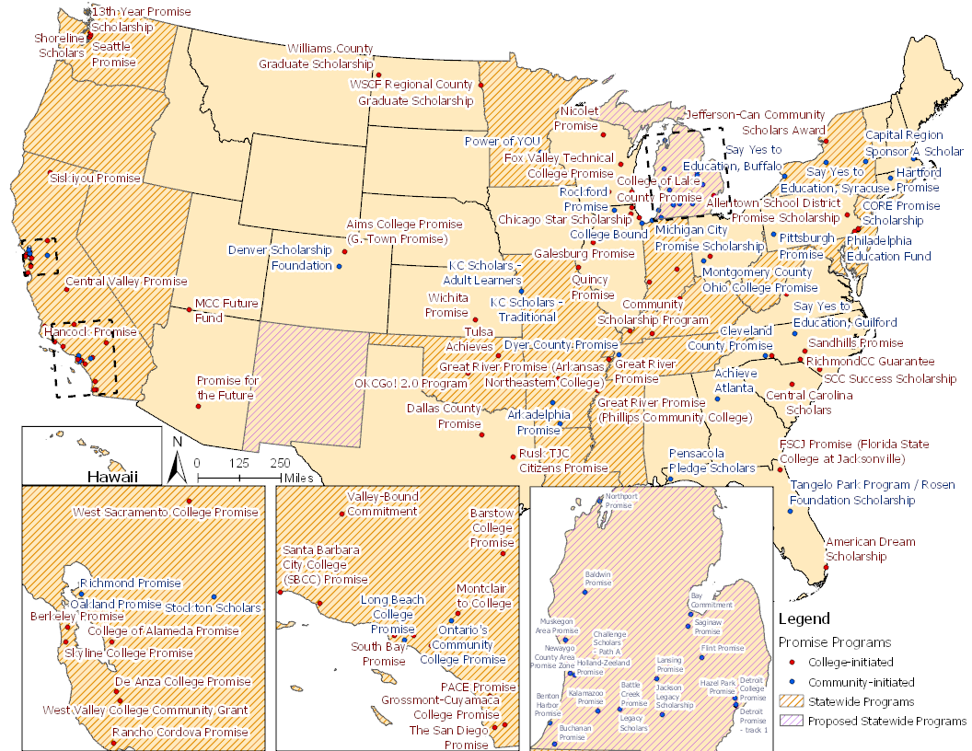
The Promise Landscape* * Based on @150 programs in Upjohn Institute’s Promise Programs Database

Slide 8
Potential Promise Program Outcomes
STUDENT SUPPORT
COMMUNITY ALIGNMENT
Post-secondary outcomes
Community development outcomes
Birth to grade 12 outcomes
Notes:
Jen – slides 8-12
Three domains for outcomes – pre-K through 12 impacts, post-secondary impacts, community-level impacts
Pipeline –progress along the way is linked, success in later stages builds on success in earlier stages
Underscores need for student support and (for local programs) community alignment along the way
Point out that in some types of programs the hypothesized relationship begins in one outcome area and progresses through the others in a cascade effect. In the case of locally-intiated, this is often birth-grade 12 yields postsecondary outcomes which yields community development. In community college-initiated programs, the initial effects are directly on post-secondary outcomes and spread (maybe) to birth to grade 12 spaces and community development outcomes.

Slide 9
Statewide programs
Outcome Area | Possible Outcomes
Birth to Grade 12 | Spillover effects on college-going culture and readiness, high-school graduation rates, FAFSA completion and Pell uptake
Post-secondary | Increased enrollment, persistence and completion; transfer rate from 2-year to 4-year schools
Community & economic development | Better alignment with state workforce needs; attraction of new businesses, creation of new jobs
Notes:
Add TCF definition: “Promise programs are distinct from existing state financial aid in that they provide at least free or debt-free tuition to a significant subset of students who are not chosen based primarily on merit considerations.” Includes programs with GPA requirements of 2.5 or less.

Slide 10
Community-initiated programs
Outcome Area | Possible Outcomes
Birth to Grade 12 | Increased K-12 enrollment Higher aspirations / college-going culture Improved academic achievement / behavior
Post-secondary | Increased enrollment Better matching Improved persistence Increased completion
Community & economic development | School district enrollment impact Housing values Migration Workforce outcomes

Slide 11
College-initiated programs
Outcome Area | Possible Outcomes
Birth to Grade 12 | Higher ed geographic sending area response to increased access; Pathways to specific institution strengthened
Post-secondary | Increased access and persistence Impact of messaging as well as $$$ Equity focus Other institutional goals
Community & economic development | Increase in adults with a credential living in the local community
Notes:
Colleges initiate these programs b/c they have some institutional goals: recruit more students (locally?), retain them, support them through completion, perhaps increase diversity? Institutions are presumably evaluating how they're doing on this. Other goals like increasing the visibility of the institution in the broader community, etc.

Slide 12
Research summary
Rigorous, outcomes-focused research studies that use methodology to assign causation
Relevant studies can be accessed through the Upjohn Institute’s website.
If you have new or updated studies that should be reviewed and included in this summary, please contact the presenters.
Topic studied with rigorous, causal methodology
No causal research publicly available
✔
Positive and statistically significant effects found
*
Mixed results found
Notes:
The following slides summarize the findings of rigorous research studies that have investigated the various outcomes of Promise programs.
Only those studies that use a methodology that can assign causation are included here. Other information about program outcomes may come from administrative data, descriptive studies, institutional research units, or dashboards compiled by Promise programs or outside evaluators.
Green cells indicate that a topic has been studied. Light gray cells indicate that no causal research has taken place in this area. Dark gray cells signify quasi-experimental methodologies with some limitations. Check marks signify that positive and statistically significant effects have been found. Asterisks indicate mixed results.
Relevant studies can be accessed at this link.
If you have new or updated studies that should be reviewed and included in this summary, please contact the presenters.

Slide 13
K-12 impact summary
Impact Area | Community- initiated | College- initiated | Statewide
Aspirations & college-going culture | ✔ |  | ✔
School district enrollment | ✔ | NA | NA
Achievement | ✔ | NA | NA
Notes:
K-12 impacts
Outcomes down left hand side– aspirations/college culture, enrollment in district, achievement
Across the top, types of Promise programs
Gray not explored via rigorous quasi-experimental or systematic studies
Green….positive finding, check mark significant; Gray - not explored
Lots of nuance– studies explore race and class with interesting findings.
Local community initiated- Across locally-initiated programs, when studied, the findings are positive and statistically significant
- highlight Kalamazoo and El Dorado as the most fully studied in this category
State initiated-note FAFSA completion rates in Oregon, Tennessee, and Rhode Island as evidence of changes in high school

Slide 14
Spotlight: El Dorado Promise Dr. Gary Ritter, Saint Louis University
Compared to similar students across Arkansas, El Dorado students in grades 3-8 grew more on state standardized exams in math from 2007 through 2012
Differences are statistically significant and meaningful
Benefits persist over multiple years
Benefits driven by high ability students from traditionally under-served (economically-disadvantaged or African-American) student groups
Multiple Analytic Strategies
El Dorado students matched to similar peers in similar districts
District-level difference-in-differences
District-level synthetic control

Slide 15
El Dorado Promise: K-12 test scores
Matching: Promise led to a 0.113 standard deviation increase in math achievement
Find larger effects for students with higher pre-Promise achievement, regardless of race/ethnicity or SES

Slide 16
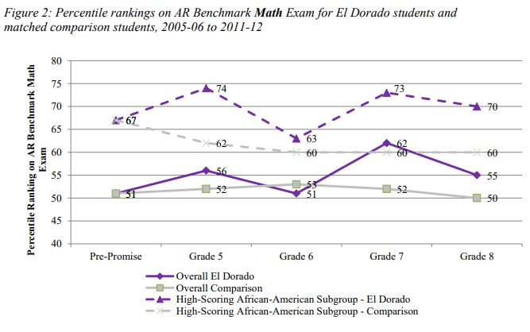
El Dorado Promise: differential benefits Greater gains by African-American students in upper half of academic distribution
High-Scoring African-American Subgroup:
Gains 10 %ile points on comparison students
Full sample of El Dorado students:
Gains 5 %ile points on comparison students

Slide 17
El Dorado K-12 test score impacts – How?
What was the mechanism for change? Interviews suggested with El Dorado educators suggested:
Discussions of college permeate the district, from the first day the kindergarteners receive their Promise backpacks
District educators now have enhanced expectations for ALL students
Educators encourage advanced coursework for ALL students

Slide 18
Postsecondary impact summary
Impact Area | Community- initiated | College- initiated | Statewide
Post-secondary enrollment | ✔ |  | *
Matching | ✔ | NA
Persistence | ✔ |  | Non-causal
Degree completion | ✔ |  | Non-causal
Notes:
Michelle – slides 15-22
Postsecondary impacts
Outcomes down left hand side–postsecondary enrollment, matching, persistence, degree completion
Across the top, types of Promise programs
Gray not explored via rigorous quasi-experimental or systematic studies
Green….positive finding, check mark significant; Gray - not explored
Lots of nuance– studies explore race and class with interesting findings.
Local community initiated- Across locally-initiated programs, when studied, the findings are positive and statistically significant. Most studied communities are Kalamazoo, El Dorado, Pittsburgh, and Say Yes. Note design variations.
Community college-initiated
State initiated- will depend on program structure, many of them are quite new, no rigorous studies

Slide 19
Statewide programs
 | Tennessee Promise | Oregon Promise
Year started | 2014 | 2016
Eligible students | All high-school graduates | High-school graduates with 2.5 GPAs
Post-secondary institutions | Community colleges, Colleges of Applied Technology; attend full time; no regain provision | Community colleges; attend at least half time; no regain provision
Structure of scholarship | Last dollar; FAFSA required; Average award @ $1,035 | Last dollar-plus ($1,000 stipend); FAFSA required; $50 co-pay. Average award @$1,500
Other requirements | Mentorship (“low-touch”) and community service required each term | First-year experience course required
Notes:
Key distinctions are 2.5 GPA requirement for Oregon Promise, last-dollar-plus stipend in Oregon, mentorship component in Tennessee

Slide 20
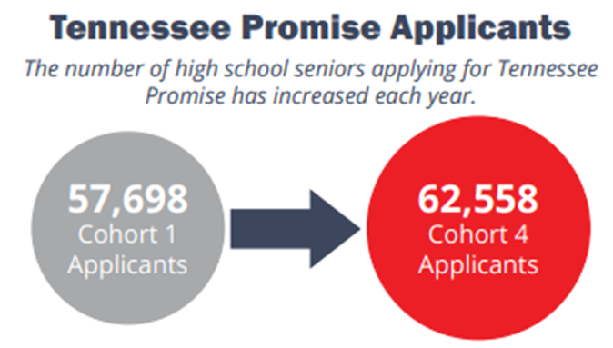
Spotlight: Tennessee Promise data Dr. Emily House, Tennessee Higher Ed Commission
Take up increasing year-over-year
Program is mature, but hype has not died down.
Vast majority of high school seniors sign up:
90+ percent of PUBLIC high school seniors
80+ percent of ALL high school seniors

Slide 21
Tennessee’s FAFSA filing rate is highest in the nation
2018
79.4%
2017
73.5%
2016
70.3%
2015
69.5%
2014
60.4%
Notes:
Since TN Promise, FAFSA filing among high school seniors in TN (public and private HSs) has increased by 13 percentage points.
TN has been first in the nation for FAFSA filing for the past 3 years, and is leading the nation currently with about 79 percent filing
Working to close gaps re: equity; work with those who file a FAFSA but don’t actually enroll (about 25 percent of filers.)
Tracking by state and by high school each week, providing feedback to principals, counselors, etc.

Slide 22
Statewide college-going rate – the “new normal”
Notes:
Student debt -- Borrowing decreasing; TN 10th lowest (~$25K)
Decline in enrollments at many four-year institutions, especially in year 1

Slide 23
Spotlight: Oregon Promise Dr. Oded Gurantz, University of Missouri
Did Oregon’s adoption of a statewide, tuition-free community college program increase community college attendance?
If so, was this due to increased community college attendance or decreased attendance at four-year institutions?
Concerns that beginning at a two-year college can decrease degree completion

Slide 24
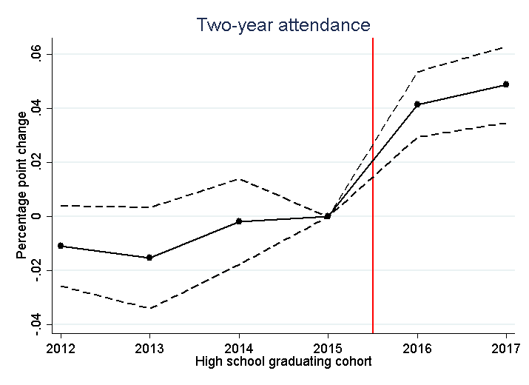
Oregon Promise results
Increase of ~4 to 5 percentage points in community college attendance
Notes:
These are causal; quasi-experimental program design

Slide 25
Oregon Promise results
Aid shifted sector of post-secondary enrollment
First year: shift away from four-year colleges
Second year: increases in overall attendance
Signal of affordability may be key lever
Increased salience of cc’s due to state’s messaging campaign
Neediest students get least amount of money
Students may not understand award amount
Changes in award structure may have contributed to confusion
Notes:
Design matters – 2.5 GPA cutoff limited new students coming into cc’s; cc’s drew from students who would otherwise have attended 4-year colleges

Slide 26
Spotlight: Pittsburgh Promise
The Pittsburgh Promise caused postsecondary enrollment to rise from approximately 74 to 79 percent among consistently Core-eligible students, and postsecondary persistence into the second year to improve by a similar margin
Notes:
Jen – slides 23-24
The Pittsburgh Promise is one of Pittsburgh’s signature educational reforms. The initiative began with the Pittsburgh Public Schools (PPS) class of 2008 with support from local industry and philanthropy, including a $100 million challenge grant from University of Pittsburgh Medical Center and over $10 million each from the Grable Foundation, the Heinz Endowments and The Pittsburgh Foundation.
Give eligibility requirements, Core/Extension, and eligible IHEs
In first 5 years of Pittsburgh Promise, 71% of graduates eligible for some form of scholarship and of those, 64% used in the first year after HS graduation
This enrollment increase is driven entirely by Core-eligible students attending four-year colleges and universities. Given the number of eligible students in this first five years of the Promise, this translates to approximately 200 additional PPS graduates enrolling in postsecondary education who would not have enrolled otherwise. This is in addition to those PPS students who would have attended a postsecondary institution even without Promise support.

Slide 27
Other Pittsburgh Promise findings
Keeping talented PPS graduates in-state for postsecondary education
At the $10,000 per year level, Promise makes a four-year institution a more viable option for many and particularly increases postsecondary persistence
Substantially improved postsecondary affordability for PPS students
Promise impacts are similar for students regardless of race or socioeconomic status (SES)
The financial investment in the Promise has a positive rate of return
Notes:
The Promise is keeping talented PPS graduates in-state for postsecondary education. Students consistently eligible for the full Promise are especially more likely to remain in state for postsecondary education as a result of the Promise. Before the Promise’s inception, approximately 58 percent of these students attended postsecondary institutions in state. With the Promise’s introduction, this rate increased to 68 percent. This translates to approximately 400 students selecting PA postsecondary institutions as a result of the Promise. Combined with point #2, this implies that approximately 200 students enrolled in PA institutions rather than attending outside of the state. In sum, the Promise is encouraging talented PPS graduates to remain in PA for postsecondary education, is encouraging students and families to invest in PA institutions of higher education, and likely is increasing the probability of these talented graduates contributing to the Pittsburgh and/or western PA economy in the future.
The $10,000 per year Promise award makes a four-year institution a more viable option for many and particularly increases postsecondary persistence. In its third phase, when the Promise reached its maximum level of generosity ($10,000 / year), enrollment in a four-year institution increased among students at the threshold for eligibility from 22 percent to 35 percent, and enrollment and persistence in any postsecondary increased from 23 percent to 41 percent at the eligibility margin. In fact, impacts on four-year postsecondary enrollment and persistence are largest when the Promise was at full generosity. In a separate analysis, we find that the Promise has the largest impact on enrolling at an institution well matched to the student’s academic credentials when the Promise was most generous.
Impacts of this magnitude are quite substantial and imply that these Promise funds made a four-year institution a truly viable option. A critical feature of the Promise at this time was that funds could be used for costs of attendance beyond tuition and fees (e.g., room and board). Providing support for these non-tuition expenses may be important for low-income Promise recipients, in particular, whose tuition and fees may be covered by other need-based aid, such as Pell and PHEAA. With Promise funds limited to tuition and fees only, the lowest-income Pittsburgh students, perhaps counterintuitively, likely will be those left without Promise support. This may raise equity concerns.
Page, L. C. & Iriti, J. (2016). On undermatch and college cost: A case study of the Pittsburgh Promise. In Kelly, A. P., Howell, J. S. & Satin-Bajaj, C. Matching students to opportunity: Expanding college choice, access, and quality. Cambridge, MA: Harvard Education Press.

Slide 28
Community/economic development impact summary
Impact Area | Community- initiated | College- initiated | State-initiated
Housing values | ✔ | NA
Migration impact | ✔ | NA
K-12 enrollment | ✔ | NA | NA
Workforce outcomes | ✔
Notes:
Brad – 25 and ff
Community/economic development impacts
Outcomes down left hand side–housing values, migration impact, rate of return, and school district enrollment
Across the top, types of Promise programs
Gray not explored via rigorous quasi-experimental or systematic studies
Green….positive finding, check mark significant; Gray - not explored
Lots of nuance– studies explore race and class with interesting findings.
Local community initiated- Across locally-initiated programs, when studied, the findings are positive and statistically significant. Most studied communities are Kalamazoo, Say Yes, and a mulit-site study. Note design variations– nature of the Promise design likely powerfully affects whether community/economic development impacts are realized.
Very under-studied in terms of impacts. Odd, too, considering these are the goals that help set place-based programs apart!
Decline in out-migration from areas around Promise programs
Hard to study b/c of lack of ready data sets and multiple causes affecting outcomes
Explain that enrollment effect is both a K-12 impact and a community-level impact
Community college-initiated
State initiated-

Slide 29
Spotlight: Kalamazoo Promise Dr. Brad Hershbein, W.E. Upjohn Institute
What are the Promise’s longer-term effects on students, besides educational attainment?
Several projects underway to measure socioeconomic outcomes:
10-year alumni survey
Administered 10 years after high school graduation, when Promise eligibility ends
So far, three waves of results, including pre-Promise classes (2003−2005) and three Promise-eligible classes (2006−2008)
Asks range of questions from Promise experience to financials to wellbeing
Workforce Indicators
Unemployment Insurance records from State of Michigan, matched to KPS graduates
Captures employment, wages, location (ZIP), and unemployment claims

Slide 30
Where do KPS grads live before and after the Promise?
Promise classes are much likelier to live close to Kalamazoo, 10 years after HS graduation.
Source: Authors’ calculations from Kalamazoo Promise 10-year alumni survey. Responses have been weighted to be representative of each graduating class.

Slide 31
How much student debt do KPS grads have before and after the Promise?
Before Promise: 41% of students had $25k+ student debt
After Promise: 22% of students did
Source: Authors’ calculations from Kalamazoo Promise 10-year alumni survey. Responses have been weighted to be representative of each graduating class.

Slide 32
What share of KPS grads are working (above minimum wage)?
2006-2008
2009-2011
2003-2005
Promise-era grads less likely to work during college-going years, but catch up, if not exceed, afterward
Source: Authors’ calculations from matched KPS-Michigan UI data. Responses have not been adjusted for nonresponse/selection bias. Graph shows share of matched records with annual earnings exceeding a threshold of the state minimum wage ($9.45) at half-time, about $9,450 per year.

Slide 33
How much are KPS grads earning?
2003-2005
2009-2011
2012-2014
2006-2008
Promise-era grads steadily earn more money through successive cohorts
Source: Authors’ calculations from matched KPS-Michigan UI data. Responses have not been adjusted for nonresponse/selection bias. Graph shows median annual inflation-adjusted earnings for those exceeding a threshold of the state minimum wage ($9.45) at half-time (about $9,450 per year).

Slide 34
Longer-term outcomes summary
These projects are part of a Strada Education Network grant to study workforce and long-term student outcomes in four Promise communities
Kalamazoo (Upjohn team), Pittsburgh (U Pitt team), Denver (CU-Denver team), and Knox County (forerunner of TN Promise; U TN team)
More complete results expected by PromiseNet 2020 in Kalamazoo
Knox Achieves sneak peek:
Preliminary: Higher earnings after college (3−6%), higher likelihood of working, participation in better-paying industries
Kalamazoo sneak peek:
Preliminary: Higher earnings after college for later cohorts (not necessarily causal)

Slide 35
College Promise Campaign Robyn Hiestand, Director of Research and Policy
Notes:
Robyn – 27-29

Slide 36
Financial sustainability survey
Does your program have financial sustainability concerns?

Slide 37
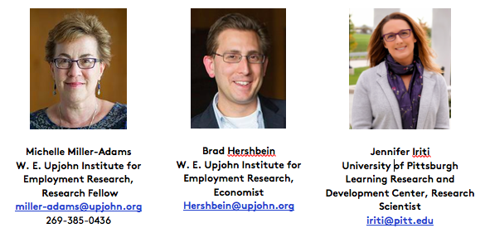
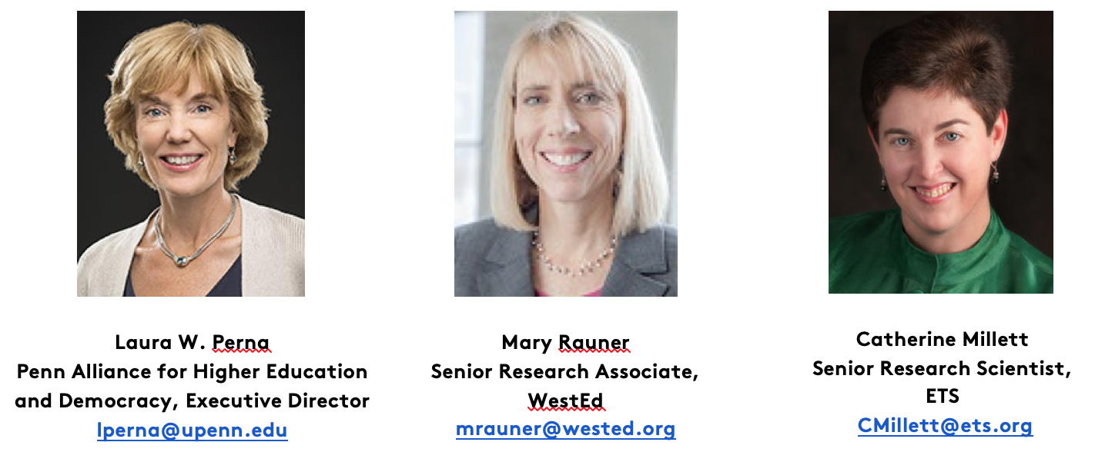
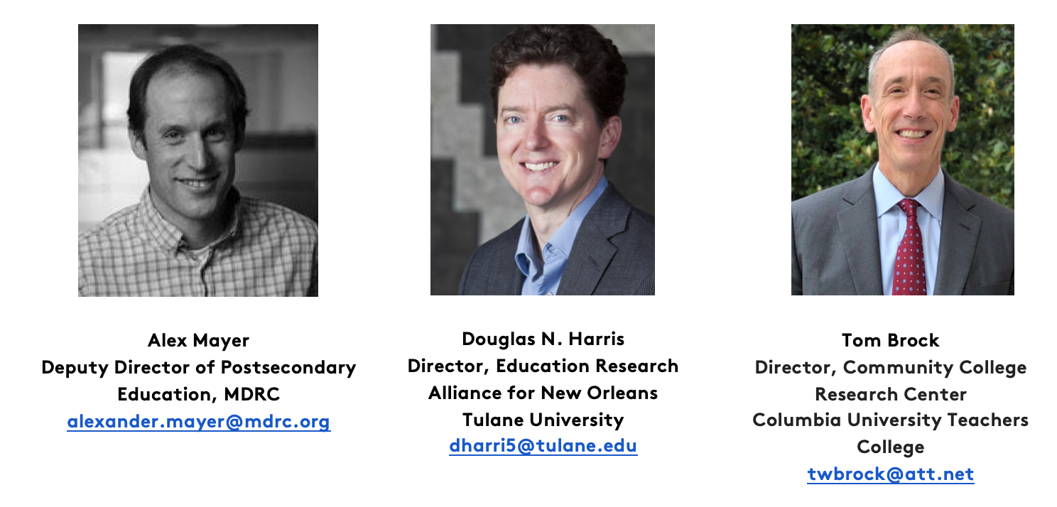
Steering Committee Members
College Promise Research Network Steering Committee
Employment Outcomes - Financial Sustainability - Program Design - Metrics/Evaluation

Slide 38
Call to Action
Most rigorous research focuses on community-initiated programs with 4-year options; research framework emerged from this group of programs.
Limited research on college-initiated and statewide programs.
Need more clarity around institutional and state goals, and how they relate to design.
Where are research efforts related to these programs located?
How (and where) to share findings from rigorous research into these outcomes?
Notes:
Michelle – 30-32

Slide 39
For more on Promise research…
Breakout Session #1 (10:15-11:30 AM)
Researchers Roundtable, Stephens Lounge, MLK Center
Breakout Session #3 (3:30-4:45 PM)
Evaluating Promise Programs, Stephens Lounge, MLK Center

Slide 40
For more information…
Upjohn Institute -- Promise Programs Research Database, Promise Monitoring and Evaluation Framework, and Research Bibliography
College Promise Campaign – Resources
PennAHEAD – College Promise Programs Database
West Ed – California College Promise Project
Presenters: Jennifer Iriti – iriti@pitt.edu Michelle Miller-Adams – miller-adams@upjohn.org Brad Hershbein – hershbein@upjohn.org Robyn Hiestand – robyn@civicnation.org Gary Ritter – gary.ritter@slu.edu

